Slide 1
What makes a game engine?

Slide 2

Notes:
Put simply?
This.

Slide 3
But Mainly…
Core Systems
Memory Allocation
Math Library
Localisation Services
Parsers
Profiling Systems
Configuration Systems
File I/O
Resource Manager
Textures
Materials
Fonts
Collisions / Physics
Game World
Audio
Video
Notes:
Start with the core systems, list all elements (parsers for text format files (XML, JSON etc.))
Resource management – loading assets into memory and ensuring we have everything we need when necessary.

Slide 4
AND…
Human Interface Devices
Game-specific interface
Physical Device I/O
Audio
Playback / Management
Audio Models
DSP Effects
Collision / Physics
Forces & Constraints
Rigid Bodies
Ray Casting
Physic / Collision World
Shapes / Collidables
Notes:
Human Interface Devices (or HID) are your keyboard and mouse, gamepads, joysticks, brain wave reading devices… whatever – it’s how a human interfaces with the computer…

Slide 5
AND …
Profiling & Debugging
Recording and Playback
Memory & Performance Stats
In-Game Menus & Console
Scene Management
Spatial Representation
Occlusion & PVS
LOD Systems
Low-Level Renderer
Materials
Lighting
Cameras
Texts & Fonts
Viewports & Virtual Screens
Debug Drawing
Graphics Device Interface
Notes:
Profiling and debugging is of utter importance, it lets us find out what’s causing our game to slow down and with a good interface, we can do that live on the fly while the game is running.
Scene management lets us optimise our world spaces, so we can ensure we’re not trying to render objects outside the camera – or even slow down their thinking processes while the player is well away from them.
Low-Level rendering is the nitty gritty systems that let us actually get stuff on the screen, the core of our visual system upon which all the shiny special effects sit.

Slide 6
AND …
Visual Effects
Particle Systems
Post Effects
Environment Mapping
Decal Systems
Gameplay Foundations
Scripting System
AI
Event / Messaging System
World Loading
Front End
Heads-Up Display
Video playback
In-Game Cinematics
In-Game GUI
In-Game Menus
Attract Mode
Notes:
Visual Effects add a bit of “sizzle” to the game, particle effects for explosions or pickup effects, post processing effects like night vision or HDR.
Gameplay Foundational systems are what the rest of the actual game rest on, so a scripting system for missions / quests / NPCs and the basic building blocks of AI (state machines? Behaviour trees?)
Then we get to the front end – what the player is going to see most often in terms of their interface to the game, menus, HUDs, GUIs and the arcade-esque attraction modes

Slide 7
AND …
That’s all before we get to the gameplay specific systems…
Game-Specific Rendering
Player Mechanics
Game Cameras
AI
Weapons
Puzzles
Vehicles
Power-Ups
Gregory, J. (2009). Game engine architecture. Wellesley, Mass.: A K Peters.

Slide 8

Notes:
There’s plenty of stuff out there to make our life easier.
We’ll take a look at some of the middleware options that can fill in some of those slots
All we need to do then is integrate them nicely into our systems and hope they work together…

Slide 9

Notes:
But before we worry about any of that, let’s start from the beginning.

Slide 10
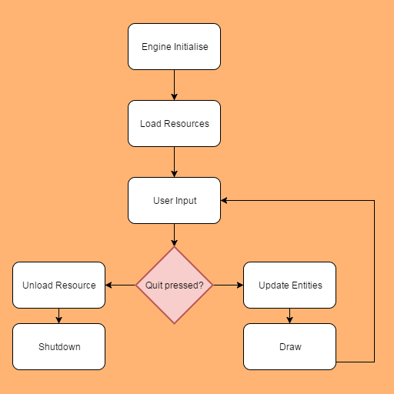
Notes:
All game engines work something a bit like this.
We have initialisation, where we load in all our subsystems and setup values – maybe by reading configuration files
Then we load any resources the game needs (larger games will do this in stages at different points, smaller games can get away with loading everything at once.)
Once everything is loaded we enter the “game loop”
We poll for user input
If they haven’t chosen to quit, we update everything currently active and then we draw everything to the screen.
If they have quit, we unload our resources
Then we make sure we tidy up any bits of memory and other elements.

Slide 11

Notes:
Let’s talk about how to actually get something like this up and running!
Doing it in a console is straight forward – we have a while loop inside the “main” function and we keep looping that until we want to quit.
It’s roughly the same in a window too, except we need to do a lot more setup to get there!
Visual Studio – New Project – Win32 Project
Application Settings – Empty Project – OK
Add - New Item – Main.cpp
#define WIN32_LEAN_AND_MEAN, include Windows.h
Declare WinMain
Add System class, move define and windows into header

